Slide 1
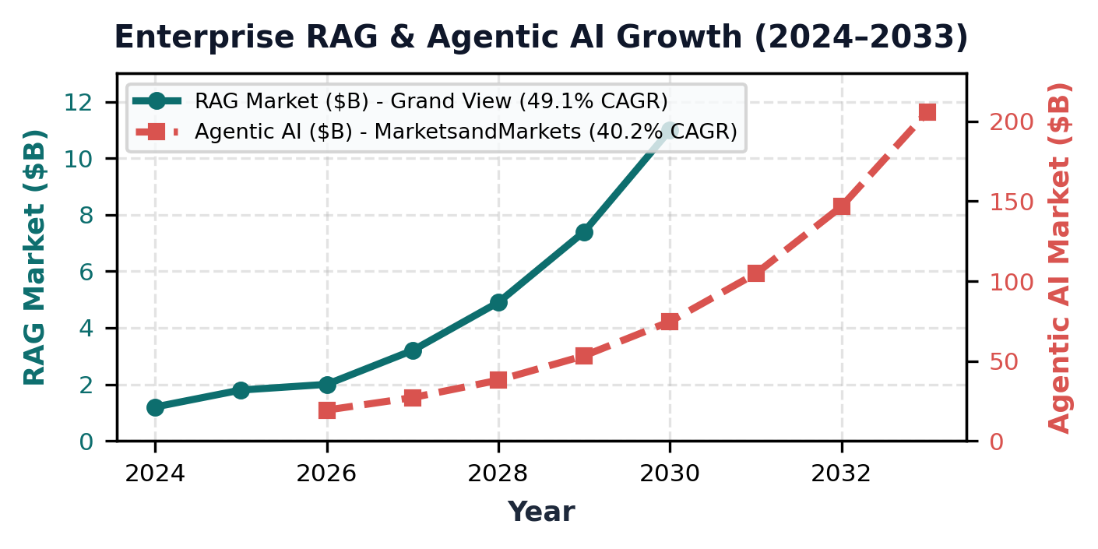
TruthGuard: Adversarial
Verification for Multi-Agent
Document Q&A
★
Business Need / Opportunity
Target Segment
• Silent Blending Crisis: Standard RAG scores <33% exact match on conflicting corpora (RAMDocs, arXiv:2504.13079) by merging stale v1 and active v2 rules.
• Adversarial Critic Cross-Check: Critic agent runs pairwise DeBERTa-v3 NLI across retrieved passages to catch direct contradictions before synthesis.
• Bi-Temporal Authority DAG: Exploits version/date metadata & 'supersedes' clauses to rank Amendment > Policy v2 > Policy v1 > FAQ.
• Claim-Span Hallucination Gate: Splits draft into atomic claims and blocks any assertion lacking verbatim retrieved passage support.
• Transparent Provenance or Abstention: Surfaces both positions with supersession proof, or explicitly abstains when conflict is unresolvable.
T
• Telecom, Media & Tech (TIME BU): SLA contracts, network SOPs, evolving API specs & regulatory tariffs
Problem Statement
B
• Banking, Financial Services & Insurance: RBI/SEBI circulars, credit policy amendments & underwriting rules
Enterprise corpora contain conflicting versions, outdated policies, contradicting FAQs, and superseded amendments. Standard RAG blindly blends disagreements into confident hallucinations.
Value Prop: TruthGuard's 4-agent verification loop detects conflicts, resolves supersession, and surfaces provenance—cutting compliance audit time by 65%.
H
• Healthcare & Life Sciences: Clinical protocol amendments, drug formulary updates & hospital SOPs
L
• Enterprise Legal, HR & Governance: Multi-jurisdiction handbooks, M&A contract addenda & vendor policies
Market Size and Growth
Future Readiness
1
2
3
4
5
Research &
Taxonomy
Define 4 conflict types & build inconsistent policy/FAQ benchmark corpus.
MVP Agent
Pipeline
Build Retriever, Synthesizer, Critic & Resolver in LangGraph + React UI.
NLI & DAG
Calibration
Add DeBERTa-v3 NLI contradiction matrix & Bi-Temporal version DAG.
MCP & Audit
Scale
Connect Confluence/Git via MCP, SHA-256 provenance & async cache.
Launch &
Replicate
Deploy on AWS Docker/K8s; replicate across TIME, BFSI, Health & Legal.
Use Case: #2 (TIME BU)
TruthGuard — Multi-Agent
Document Q&A
Team Members (VCE):
• D Abhishek Yadav
• [Team Member 2]
• [Team Member 3]
• [Team Member 4]
49.1% CAGR ($11B by 2030, RAG) by Grand View &
40.2% CAGR ($205.9B by 2033, Agentic AI) by M&M
* RAG: Retrieval-Augmented Gen; NLI: Natural Language Inference; DAG: Directed Acyclic Graph; MCP: Model Context Protocol; CAGR: Compound Annual Growth Rate.

Slide 2
Solution Details
Proof of Concept
• Adversarial 4-Agent Loop: Decouples Hybrid Retrieval and Draft Synthesis from a Red-Team Critic agent that actively tries to falsify the answer.
• 3-Vector Critic Audit: Cross-checks passages for NLI contradiction, parses version/date metadata for staleness, and flags unbacked claims.
• Deterministic Resolution: Surfaces both conflicting positions with supersession provenance, or explicitly abstains when unresolvable.
2. Retriever Agent
4. Critic Agent
Extracts date, version & authority metadata from PDFs/Policies.
Pulls top-K passages via Hybrid Dense + BM25 search.
Drafts answer with inline [DocID:Span] claim citations.
Checks NLI contradiction, staleness DAG & unbacked claims.
Surfaces both views w/ provenance OR explicitly abstains.
Unique Selling Proposition
1. Corpus Parser
3. Synthesizer
5. Resolution
01
02
Bi-Temporal Authority DAG
• Supersession Graph: DAG from dates, versions & 'supersedes' tags.
• Hierarchy Solver: Ranks Amendment > Policy v2 > v1 > FAQ.
Adversarial Critic & NLI
• Contradiction Matrix: DeBERTa-v3 NLI scores passage pairs.
• Claim-Span Verifier: Blocks claims lacking verbatim span proof.
Ask Policy Q&A
Retrieve Passages
Inconsistent Document Corpus
(Policies v1/v2, Amendments, FAQs)
Draft w/ Citations
Critic NLI Audit
1. Retriever Agent (Hybrid)
Dense bge-m3 + BM25 + Date Tags
Enterprise
Analyst
2. Synthesizer Agent
Drafts Answer w/ [DocID:Span] Claims
View Conflict Diff
03
04
3. Critic / Adversary Agent
• Cross-checks NLI contradiction
• Checks version/date staleness
• Flags unbacked claims
Key Features
• 'Git-Diff for Truth' UI: Side-by-side clause conflict delta.
• Epistemic Abstention: Flags deadlocks & SHA-256 audit log.
Impact & Success KPIs
• +19.2% QA Accuracy: Beats standard RAG on FaithEval.
• 100% Grounded (<1.8s): Zero unbacked claims via async NLI.
Ingest Amendments
Audit Abstentions
Compliance
Admin
Export Provenance
4. Resolution Step
(a) Both Positions + Provenance
(b) Explicit Conflict Abstention
* DAG: Directed Acyclic Graph; NLI: Natural Language Inference; KPI: Key Performance Indicator
• Use Case Diagram
• Working Architecture

